Slide 1


Spring 2021
SKKU Biostats and Big data
CHOONG-WAN WOO | COCOAN lab | http://cocoanlab.github.io

Slide 2
GBME Probability and Statistics
Lecture 24
Lecture 24
Multifactor Analysis of Variance
CHOONG-WAN WOO | COCOAN lab | http://cocoanlab.github.io

Slide 3
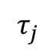
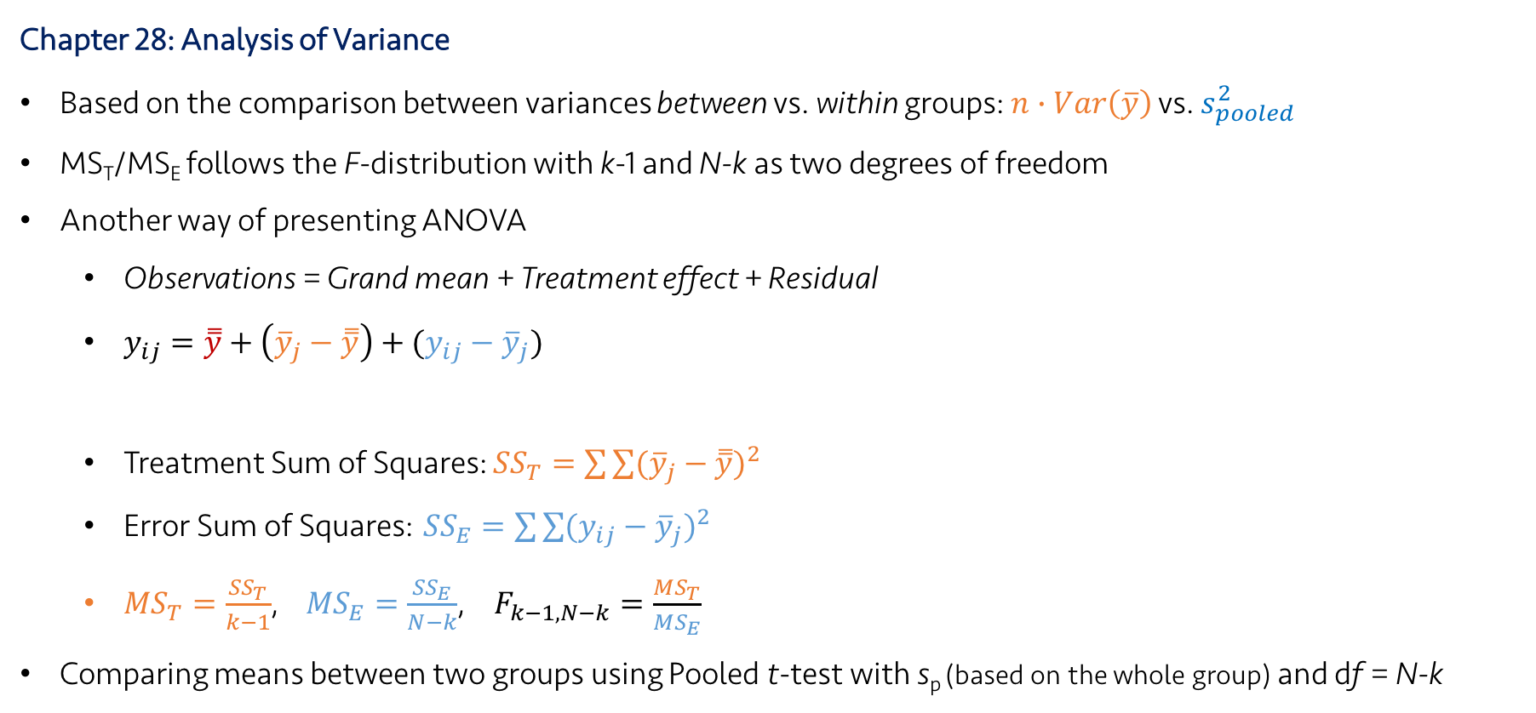
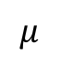
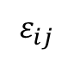
Lecture 24
Review: Key Points
Chapter 28: Analysis of Variance
Based on the comparison between variances between vs. within groups: $n∙Var\left(\overline{y}\right)$ vs. $s_{pooled}^{2}$
MS_{T}/MS_{E} follows the F-distribution with k-1 and N-k as two degrees of freedom
Another way of presenting ANOVA
Observations = Grand mean + Treatment effect + Residual
$y_{ij}=\overset{̿}{y}+\left({\overline{y}}_{j}−\overset{̿}{y}\right)+({y_{ij}−\overline{y}}_{j})$
Treatment Sum of Squares: ${SS}_{T}=\sum{\sum{{({\overline{y}}_{j}−\overset{̿}{y})}^{2}}}$
Error Sum of Squares: ${SS}_{E}=\sum{\sum{{({y_{ij}−\overline{y}}_{j})}^{2}}}$
${MS}_{T}=\frac{{SS}_{T}}{k−1}$, ${MS}_{E}=\frac{{SS}_{E}}{N−k}$, $F_{k−1,N−k}=\frac{{MS}_{T}}{{MS}_{E}}$
Comparing means between two groups using Pooled t-test with s_{p} (based on the whole group) and df = N-k
$$μ$$
$$τ_{j}$$
$$ε_{ij}$$
CHOONG-WAN WOO | COCOAN lab | http://cocoanlab.github.io

Slide 4
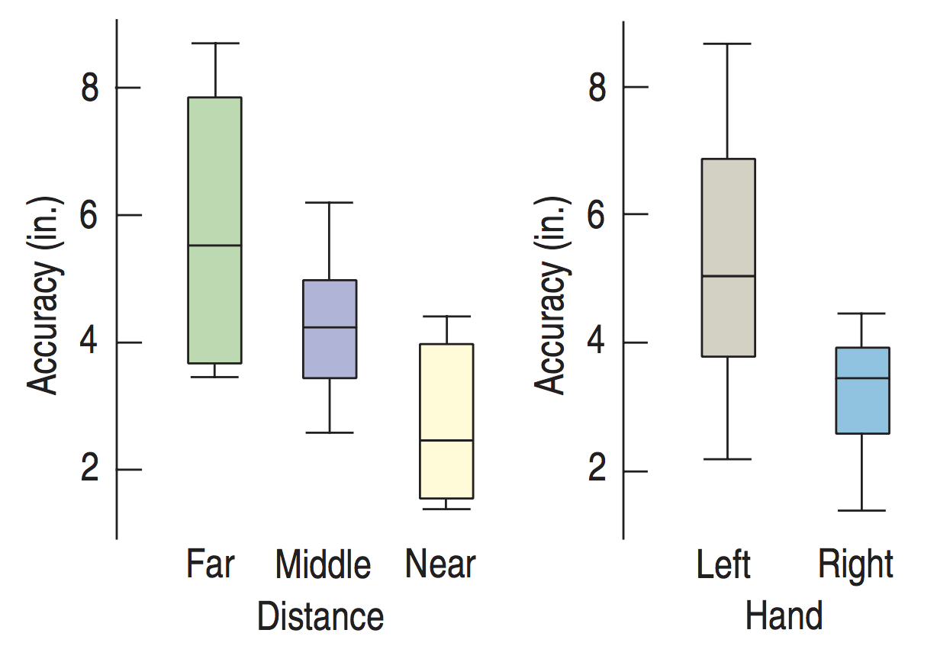
Lecture 24
Example: Dart throwing
How accurately can you throw a dart?
It may depend on which hand you use and how far from the target you are.
How can we measure the effect of each variable?
CHOONG-WAN WOO | COCOAN lab | http://cocoanlab.github.io

Slide 5
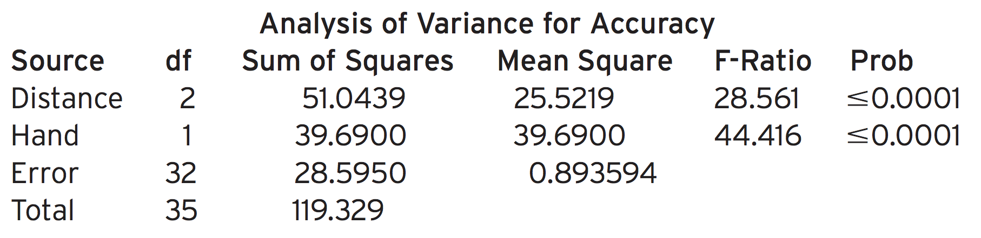
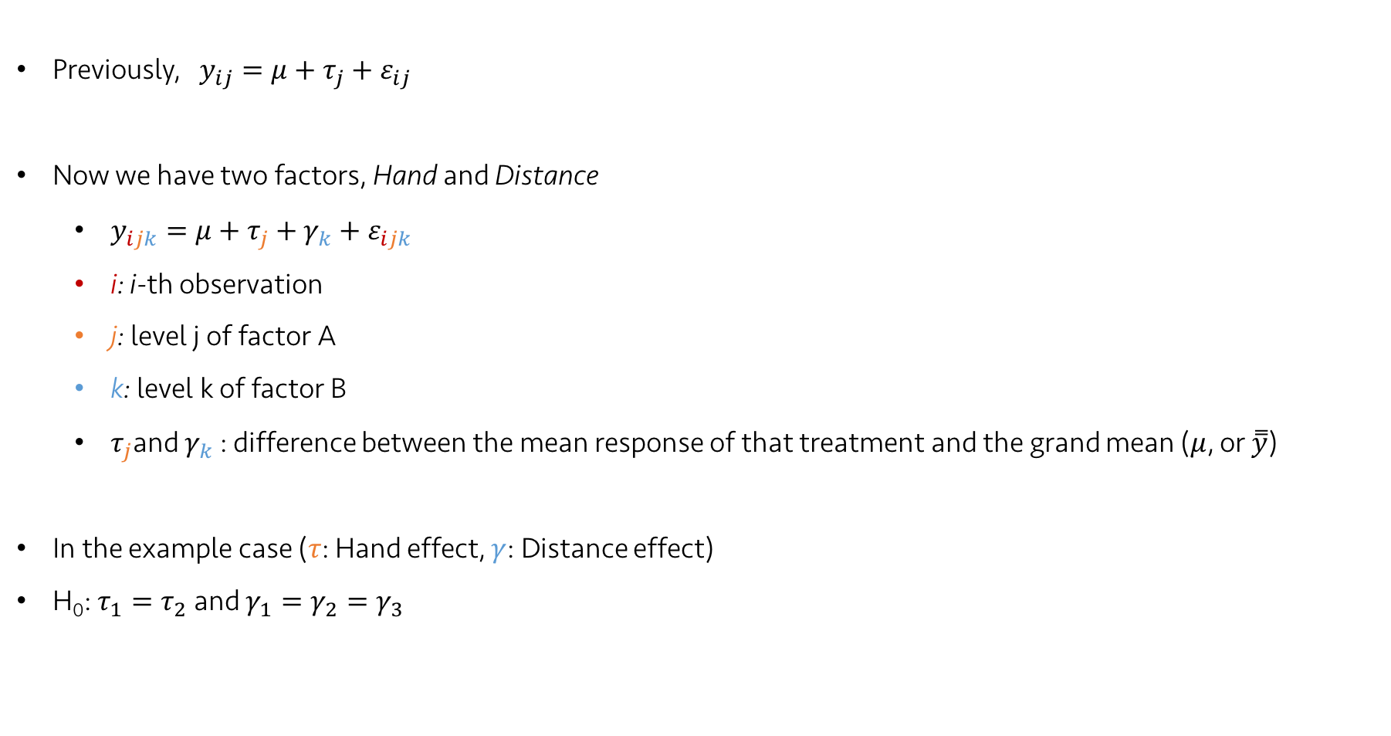
Lecture 24
Two-factor ANOVA model
Previously, $y_{ij}=μ+τ_{j}+ε_{ij}$
Now we have two factors, Hand and Distance
$y_{ijk}=μ+τ_{j}+γ_{k}+ε_{ijk}$
i: i-th observation
j: level j of factor A
k: level k of factor B
$τ_{j}$and $γ_{k}$: difference between the mean response of that treatment and the grand mean ($μ$, or $\overset{̿}{y}$)
In the example case ($τ$: Hand effect, $γ$: Distance effect)
H₀: $τ_{1}=τ_{2}$ and $γ_{1}=γ_{2}=γ_{3}$
CHOONG-WAN WOO | COCOAN lab | http://cocoanlab.github.io

Slide 6
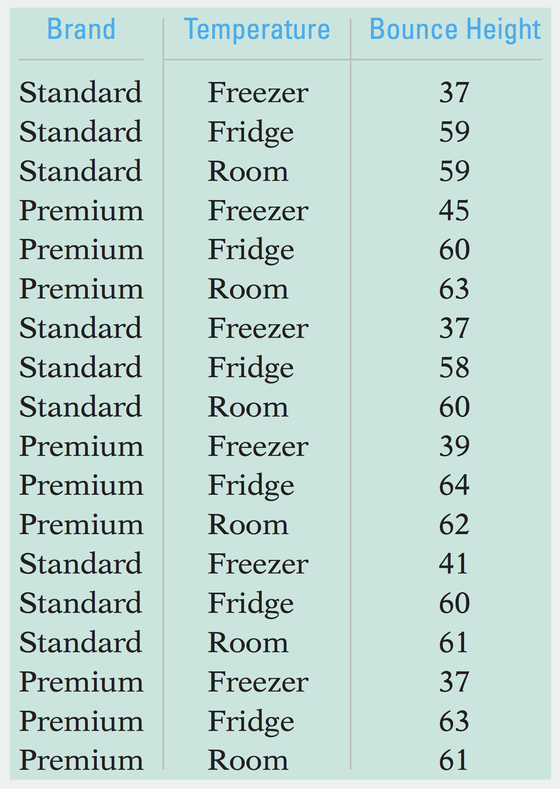
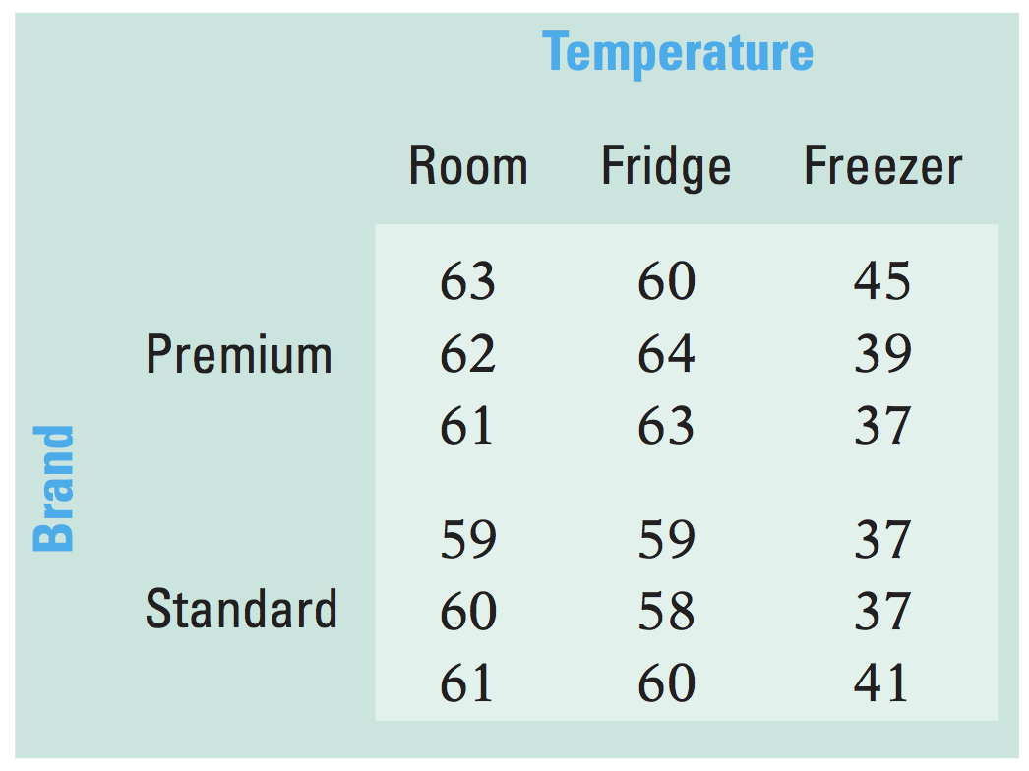
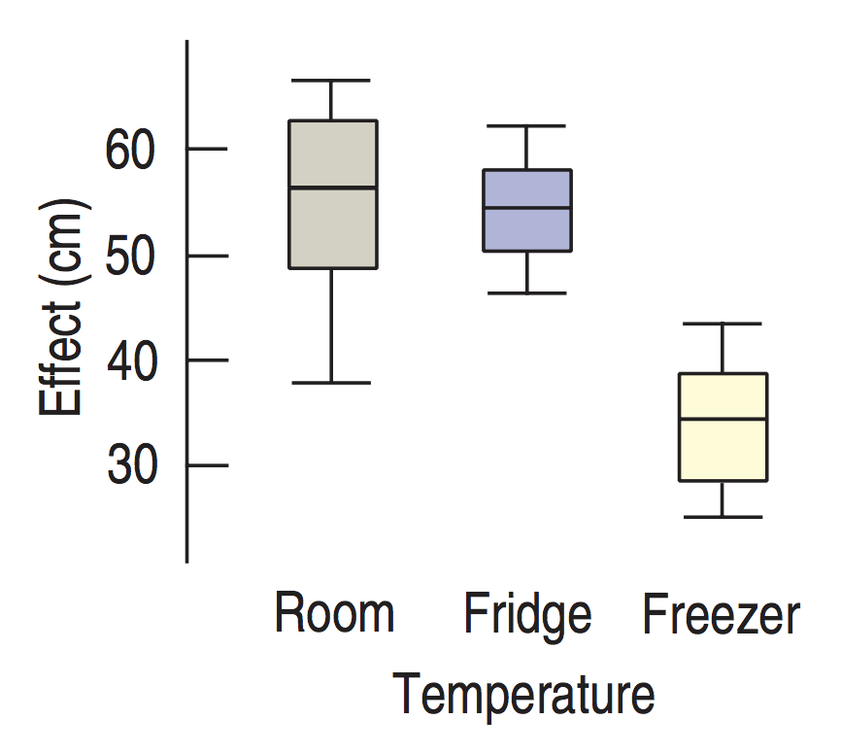
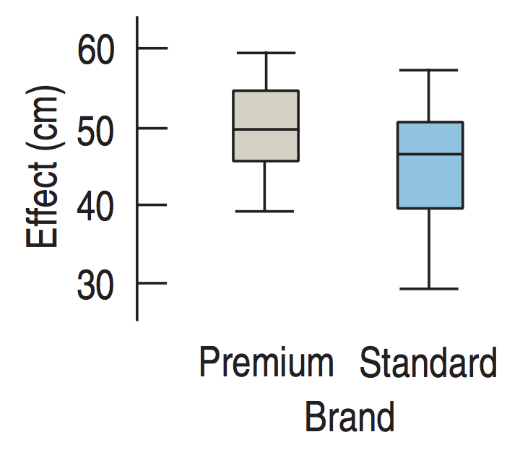
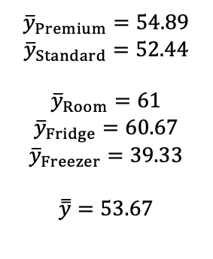
Lecture 24
How two-factor ANOVA works
Another example: tennis balls’ bounce with different brands and temperature
Side-by-side boxplots for each factor
$${\overline{y}}_{Premium}=54.89$$
$${\overline{y}}_{Standard}=52.44$$
$${\overline{y}}_{Room}=61$$
$${\overline{y}}_{Fridge}=60.67$$
$${\overline{y}}_{Freezer}=39.33$$
$$\overset{̿}{y}=53.67$$
CHOONG-WAN WOO | COCOAN lab | http://cocoanlab.github.io

Slide 7
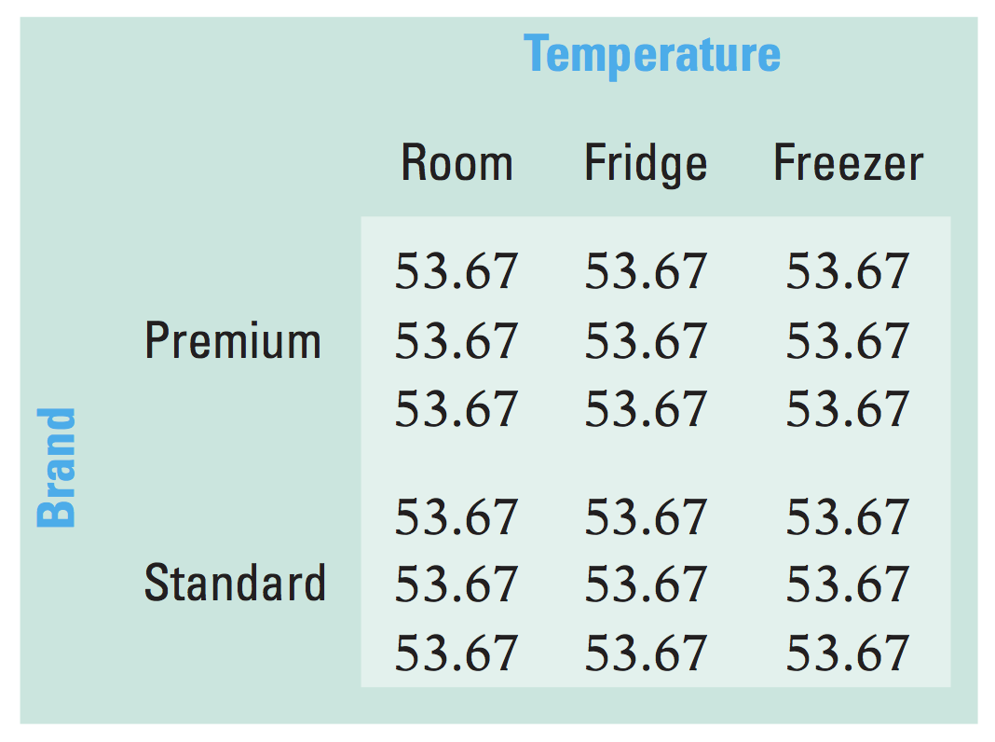
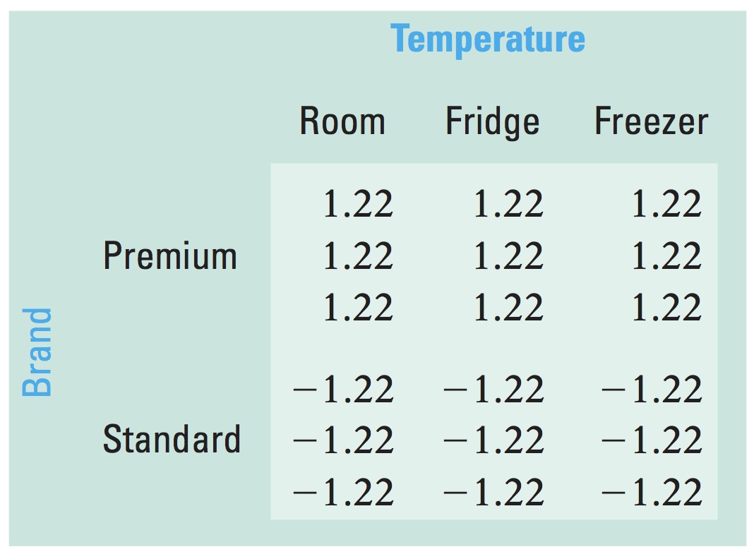
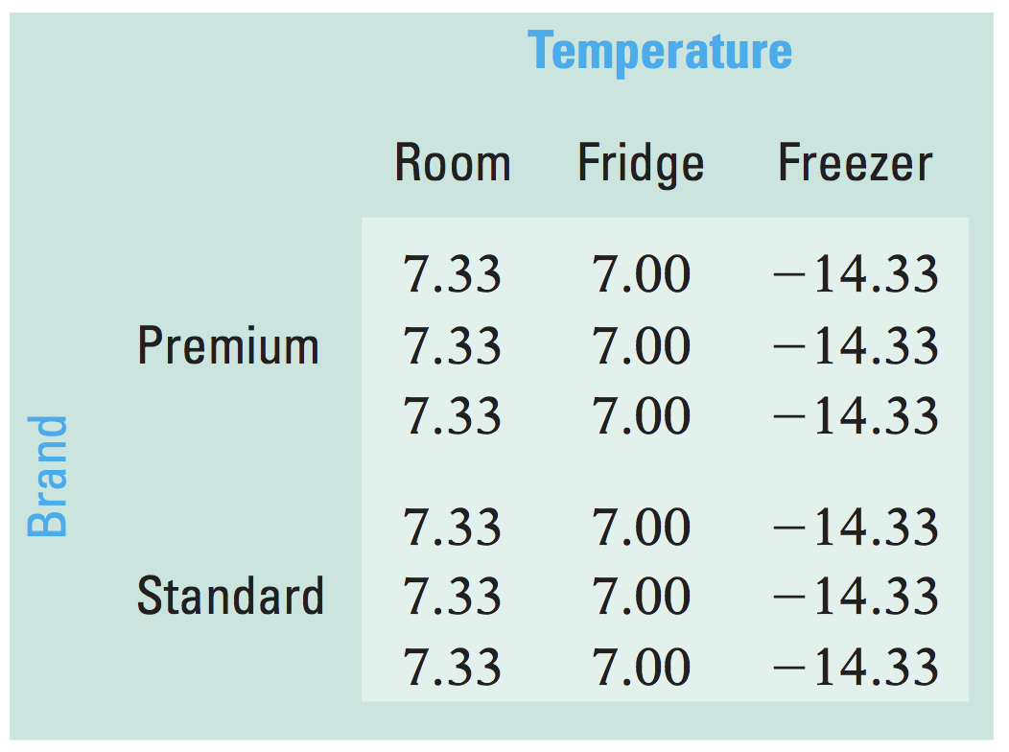
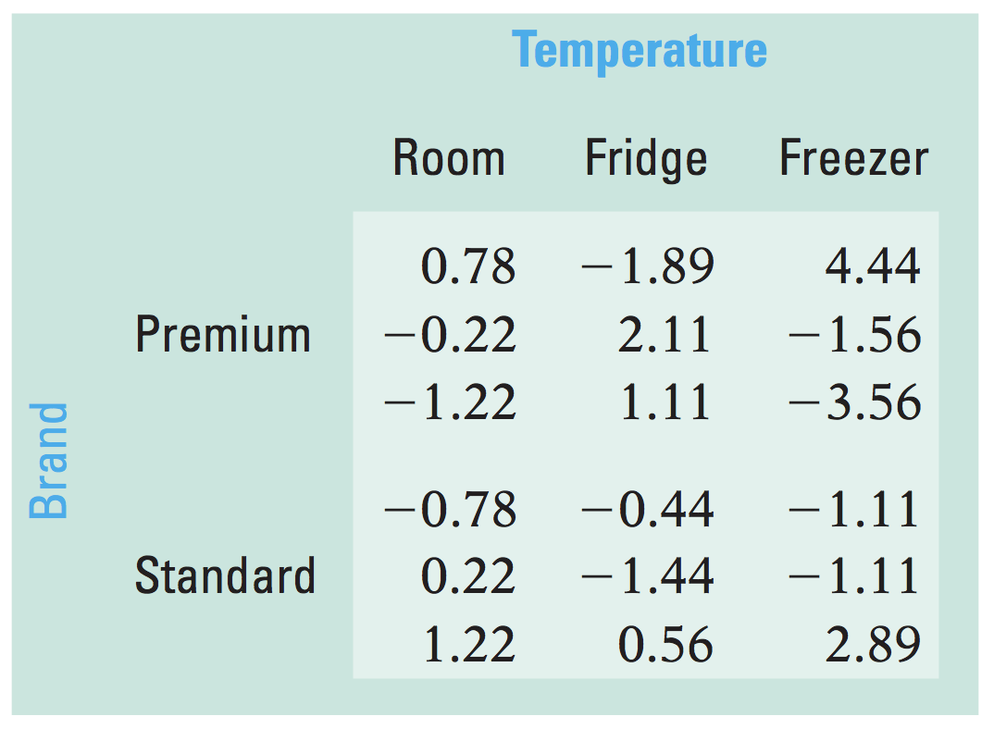
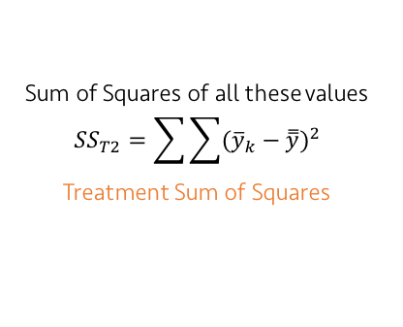
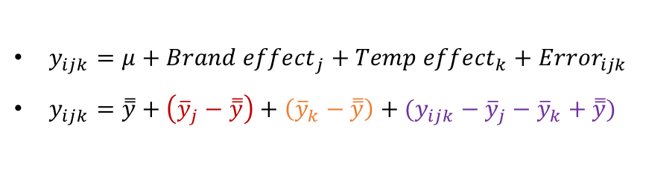
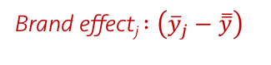
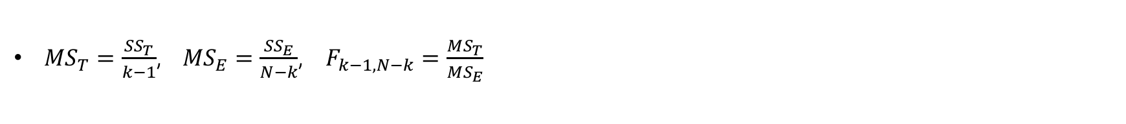
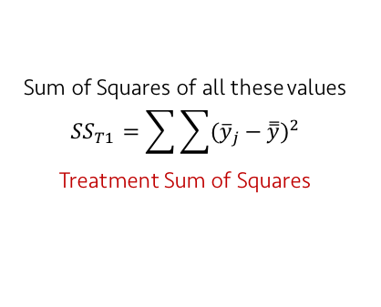
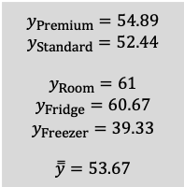
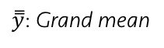
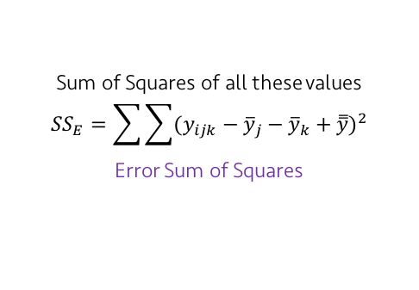
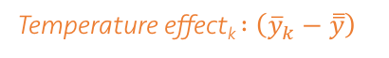
Lecture 24
How two-factor ANOVA works
$${\overline{y}}_{Premium}=54.89$$
$${\overline{y}}_{Standard}=52.44$$
$${\overline{y}}_{Room}=61$$
$${\overline{y}}_{Fridge}=60.67$$
$${\overline{y}}_{Freezer}=39.33$$
$$\overset{̿}{y}=53.67$$
$y_{ijk}=μ+{Brand effect}_{j}+{Temp effect}_{k}+{Error}_{ijk}$
$y_{ijk}=\overset{̿}{y}+\left({\overline{y}}_{j}−\overset{̿}{y}\right)+\left({\overline{y}}_{k}−\overset{̿}{y}\right)+({y_{ijk}−\overline{y}}_{j}{− \overline{y}}_{k}+ \overset{̿}{y})$
Sum of Squares of all these values
$${SS}_{T1}=\sum{\sum{{({\overline{y}}_{j}−\overset{̿}{y})}^{2}}}$$
Treatment Sum of Squares
y_{ijk}: Observations
$\overset{̿}{y}$: Grand mean
Brand effect_{j} $:\left({\overline{y}}_{j}−\overset{̿}{y}\right)$
=
+
Sum of Squares of all these values
$${SS}_{E}=\sum{\sum{{(y_{ijk}−{\overline{y}}_{j}−{\overline{y}}_{k}+\overset{̿}{y})}^{2}}}$$
Error Sum of Squares
Temperature effect_{k} $:\left({\overline{y}}_{k}−\overset{̿}{y}\right)$
Error_{ijk}
Sum of Squares of all these values
$${SS}_{T2}=\sum{\sum{{({\overline{y}}_{k}−\overset{̿}{y})}^{2}}}$$
Treatment Sum of Squares
+
+
CHOONG-WAN WOO | COCOAN lab | http://cocoanlab.github.io
${MS}_{T}=\frac{{SS}_{T}}{k−1}$, ${MS}_{E}=\frac{{SS}_{E}}{N−k}$, $F_{k−1,N−k}=\frac{{MS}_{T}}{{MS}_{E}}$

Slide 8
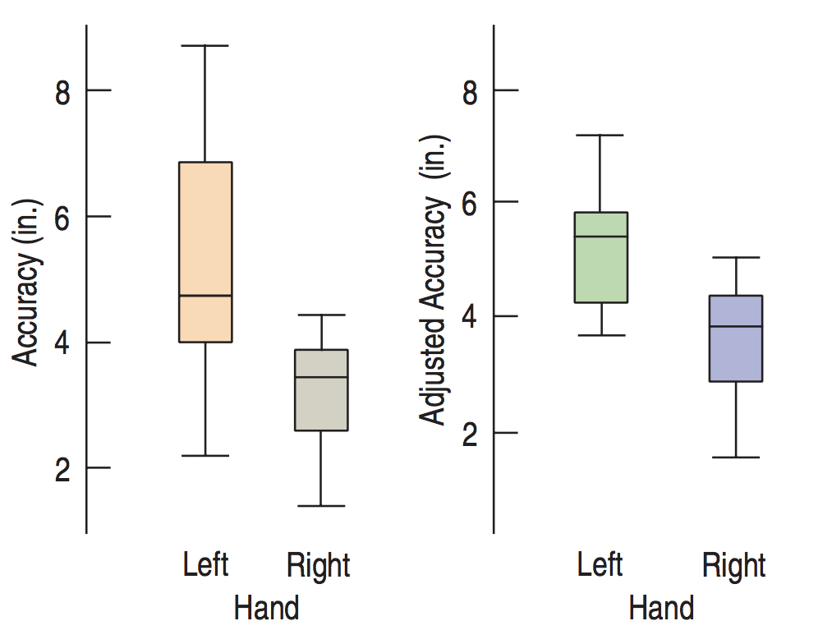
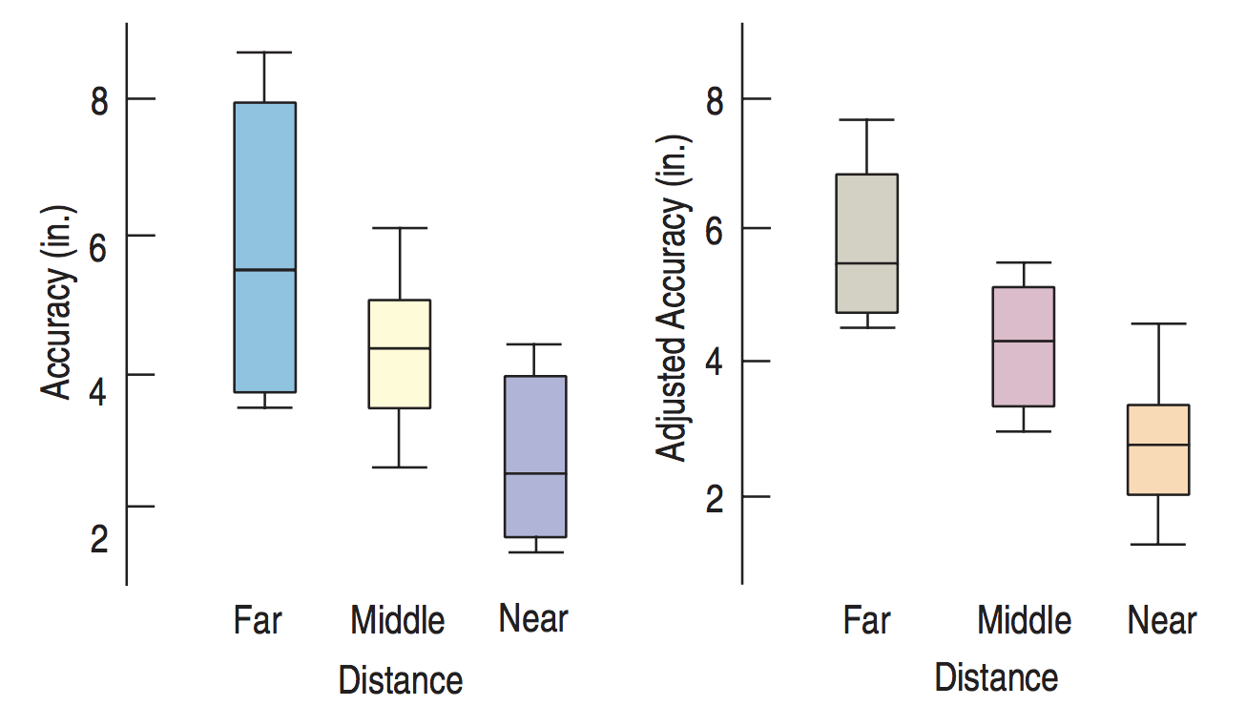
Lecture 24
Partial boxplot
Plot the data: but we cannot easily see the effects of one factor only.
Partial boxplot: plot the residuals for each level of the other factor (e.g., $y_{ijk}−{\overline{y}}_{j}+\overset{̿}{y}$).
CHOONG-WAN WOO | COCOAN lab | http://cocoanlab.github.io

Slide 9
Lecture 24
Quiz 24-1
https://forms.gle/ufmzNwHXT91JgWdp8
CHOONG-WAN WOO | COCOAN lab | http://cocoanlab.github.io

Slide 10
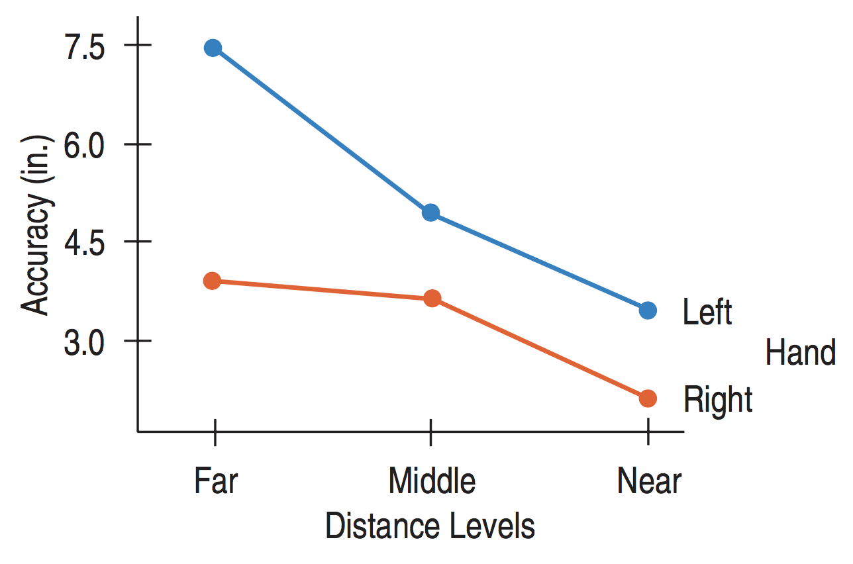
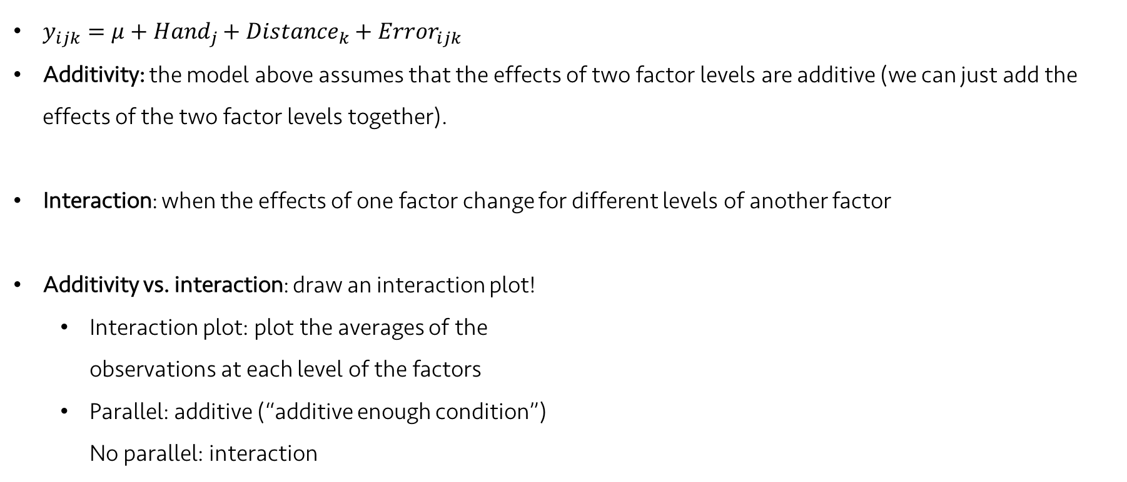
Lecture 24
Additivity vs. interaction
$y_{ijk}=μ+{Hand}_{j}+{Distance}_{k}+{Error}_{ijk}$
Additivity: the model above assumes that the effects of two factor levels are additive (we can just add the effects of the two factor levels together).
Interaction: when the effects of one factor change for different levels of another factor
Additivity vs. interaction: draw an interaction plot!
Interaction plot: plot the averages of the observations at each level of the factors
Parallel: additive (“additive enough condition”) No parallel: interaction
CHOONG-WAN WOO | COCOAN lab | http://cocoanlab.github.io

Slide 11
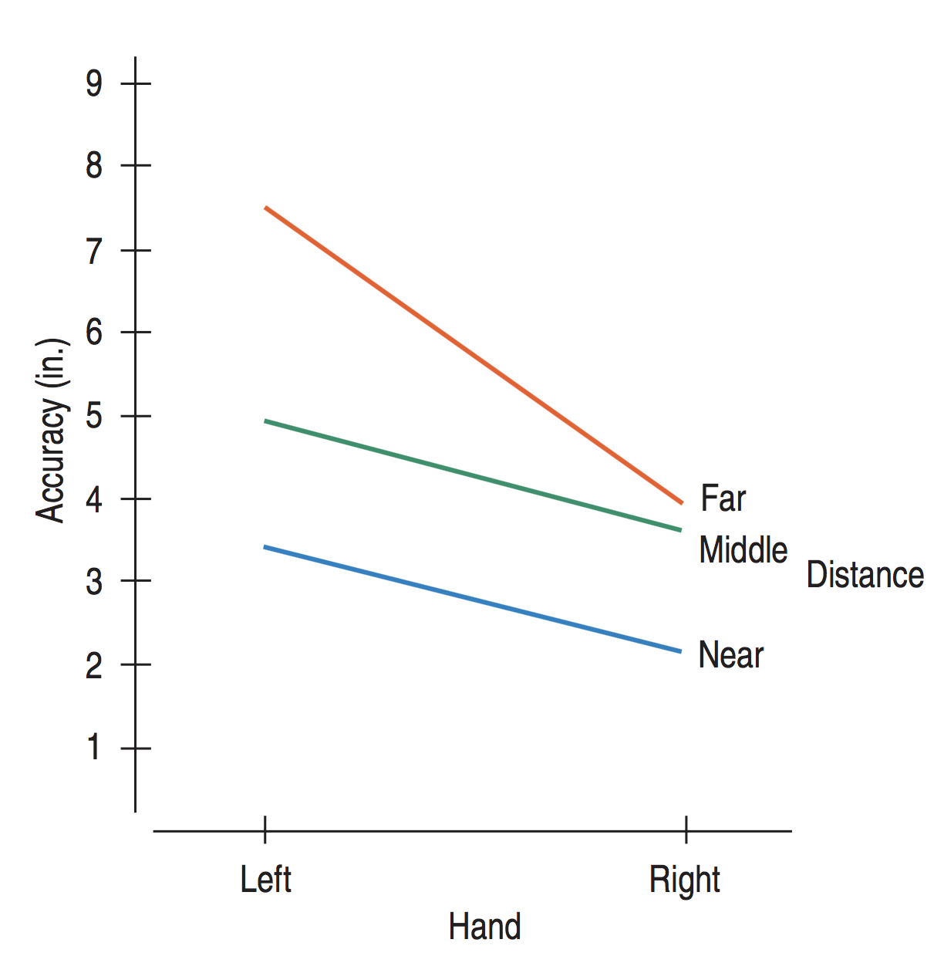
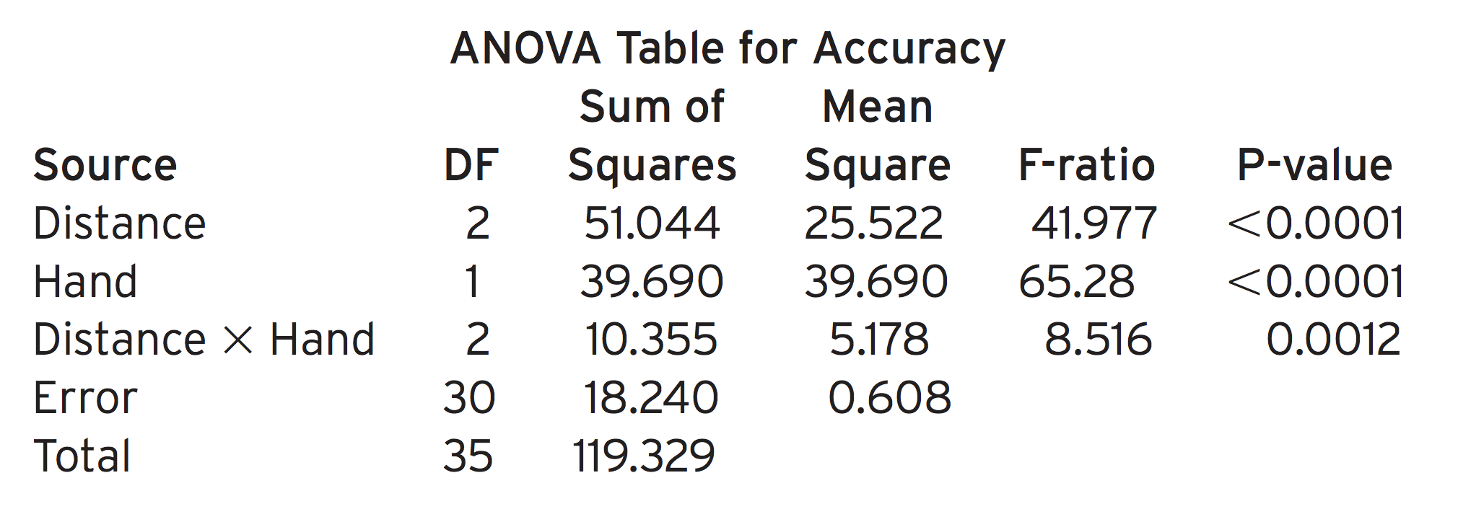
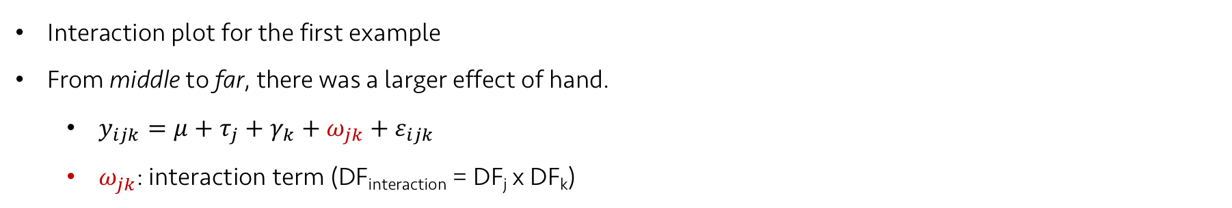
Lecture 24
Interactions
Interaction plot for the first example
From middle to far, there was a larger effect of hand.
$y_{ijk}=μ+τ_{j}+γ_{k}+ω_{jk}+ε_{ijk}$
$ω_{jk}$: interaction term (DF_{interaction} = DF_{j} x DF_{k})
ANOVA table without
the interaction term
CHOONG-WAN WOO | COCOAN lab | http://cocoanlab.github.io

Slide 12
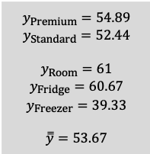
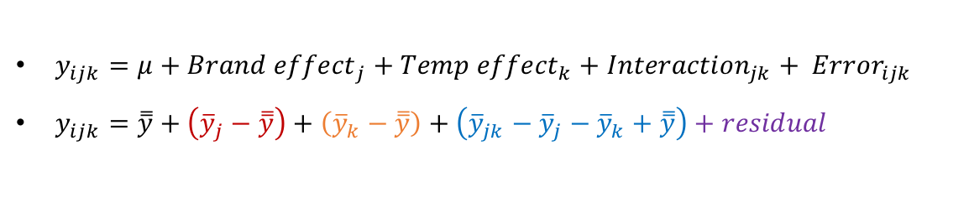
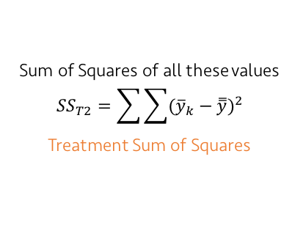
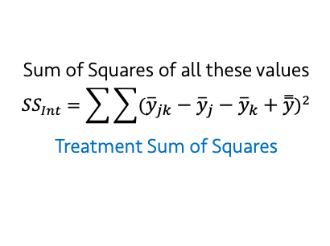
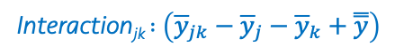
Lecture 24
How two-factor ANOVA works (with interaction)
$${\overline{y}}_{Premium}=54.89$$
$${\overline{y}}_{Standard}=52.44$$
$${\overline{y}}_{Room}=61$$
$${\overline{y}}_{Fridge}=60.67$$
$${\overline{y}}_{Freezer}=39.33$$
$$\overset{̿}{y}=53.67$$
$y_{ijk}=μ+{Brand effect}_{j}+{Temp effect}_{k}+{Interaction}_{jk}+ {Error}_{ijk}$
$y_{ijk}=\overset{̿}{y}+\left({\overline{y}}_{j}−\overset{̿}{y}\right)+\left({\overline{y}}_{k}−\overset{̿}{y}\right)+\left({{\overline{y}}_{jk}−\overline{y}}_{j}{− \overline{y}}_{k}+ \overset{̿}{y}\right)+residual$
Sum of Squares of all these values
$${SS}_{T1}=\sum{\sum{{({\overline{y}}_{j}−\overset{̿}{y})}^{2}}}$$
Treatment Sum of Squares
y_{ijk}: Observations
$\overset{̿}{y}$: Grand mean
Brand effect_{j} $:\left({\overline{y}}_{j}−\overset{̿}{y}\right)$
=
+
Temperature effect_{k} $:\left({\overline{y}}_{k}−\overset{̿}{y}\right)$
Interaction_{jk} $:\left({{\overline{y}}_{jk}−\overline{y}}_{j}{− \overline{y}}_{k}+ \overset{̿}{y}\right)$
Sum of Squares of all these values
$${SS}_{T2}=\sum{\sum{{({\overline{y}}_{k}−\overset{̿}{y})}^{2}}}$$
Treatment Sum of Squares
Sum of Squares of all these values
$${SS}_{Int}=\sum{\sum{{({{\overline{y}}_{jk}−\overline{y}}_{j}{− \overline{y}}_{k}+ \overset{̿}{y})}^{2}}}$$
Treatment Sum of Squares
-0.22
-0.22
-0.22
0.23
0.23
0.23
0.44
0.44
0.44
-0.44
-0.44
-0.44
-0.22
-0.22
-0.22
0.23
0.23
0.23
+
+
CHOONG-WAN WOO | COCOAN lab | http://cocoanlab.github.io
${MS}_{T}=\frac{{SS}_{T}}{k−1}$, ${MS}_{E}=\frac{{SS}_{E}}{N−k}$, $F_{k−1,N−k}=\frac{{MS}_{T}}{{MS}_{E}}$

Slide 13
Lecture 24
Quiz 24-2
https://forms.gle/hbcs6GKKz2uPe2GJ8
CHOONG-WAN WOO | COCOAN lab | http://cocoanlab.github.io
${MS}_{T}=\frac{{SS}_{T}}{k−1}$, ${MS}_{E}=\frac{{SS}_{E}}{N−k}$, $F_{k−1,N−k}=\frac{{MS}_{T}}{{MS}_{E}}$

Slide 14
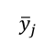
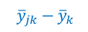
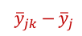
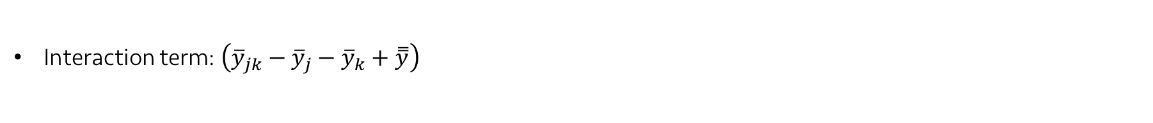
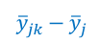
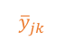
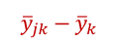
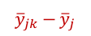
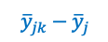
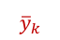
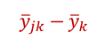
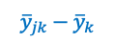
Lecture 24
What it means?
Interaction term: $\left({{\overline{y}}_{jk}−\overline{y}}_{j}{− \overline{y}}_{k}+ \overset{̿}{y}\right)$
Low interaction case
High interaction case
$${\overline{y}}_{k}$$
$${{\overline{y}}_{jk}−\overline{y}}_{k}$$
$${\overline{y}}_{jk}$$
$${{\overline{y}}_{jk}−\overline{y}}_{k}$$
$${{\overline{y}}_{jk}−\overline{y}}_{k}$$
$${{\overline{y}}_{jk}−\overline{y}}_{j}$$
$${{\overline{y}}_{jk}−\overline{y}}_{j}$$
$${\overline{y}}_{j}$$
$${{\overline{y}}_{jk}−\overline{y}}_{k}$$
$${{\overline{y}}_{jk}−\overline{y}}_{j}$$
$${{\overline{y}}_{jk}−\overline{y}}_{j}$$
CHOONG-WAN WOO | COCOAN lab | http://cocoanlab.github.io
${MS}_{T}=\frac{{SS}_{T}}{k−1}$, ${MS}_{E}=\frac{{SS}_{E}}{N−k}$, $F_{k−1,N−k}=\frac{{MS}_{T}}{{MS}_{E}}$

Slide 15
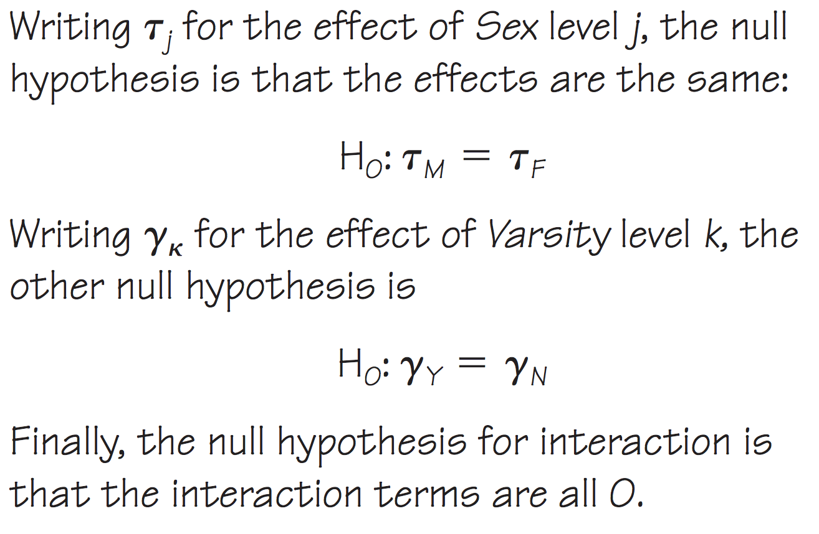


Lecture 24
Step-by-step Example
GPA (grade point averages) of four different groups of students
Two factors: gender (male vs. female), varsity (athlete team vs. non-athletes)
Three null hypotheses:
Side-by-side partial boxplot
CHOONG-WAN WOO | COCOAN lab | http://cocoanlab.github.io

Slide 16



Lecture 24
Step-by-step Example
GPA (grade point averages) of four different groups of students
Two factors: gender (male vs. female), varsity (athlete team vs. non-athletes)
CHOONG-WAN WOO | COCOAN lab | http://cocoanlab.github.io

Slide 17





Lecture 24
Step-by-step Example
GPA (grade point averages) of four different groups of students
Two factors: gender (male vs. female), varsity (athlete team vs. non-athletes)
CHOONG-WAN WOO | COCOAN lab | http://cocoanlab.github.io

Slide 18




Lecture 24
Step-by-step Example
GPA (grade point averages) of four different groups of students
Two factors: gender (male vs. female), varsity (athlete team vs. non-athletes)
CHOONG-WAN WOO | COCOAN lab | http://cocoanlab.github.io

Slide 19
Lecture 24
Quiz 24-3
https://forms.gle/1FpvG6sY6XwnRBdx5
CHOONG-WAN WOO | COCOAN lab | http://cocoanlab.github.io

Slide 20

Lecture 24
Key Points
Chapter 29: Multifactor Analysis of Variance
Multifactor ANOVA model without interaction
$y_{ijk}=μ+τ_{j}+γ_{k}+ε_{ijk}$
$y_{ijk}=\overset{̿}{y}+\left({\overline{y}}_{j}−\overset{̿}{y}\right)+\left({\overline{y}}_{k}−\overset{̿}{y}\right)+({y_{ijk}−\overline{y}}_{j}{− \overline{y}}_{k}+ \overset{̿}{y})$
Multifactor ANOVA model with interaction
$y_{ijk}=μ+τ_{j}+γ_{k}+ω_{jk}+ε_{ijk}$
$ω_{jk}$: interaction term,$\left({{\overline{y}}_{jk}−\overline{y}}_{j}{− \overline{y}}_{k}+ \overset{̿}{y}\right)$
Important plots:
Partial boxplot, interaction plot
CHOONG-WAN WOO | COCOAN lab | http://cocoanlab.github.io

